Slide 1

Service Fabric – The Real World
Microservice Ascend
Presented By: someone that still plays with cars
Notes:
Do introduction

Slide 2
This is your last chance. After this, there is no turning back. You take the blue pill - the story ends, you wake up in your bed and believe whatever you want to believe. You take the red pill - you stay in Wonderland and I show you how deep the rabbit-hole goes.
Morpheus – The Matrix
Notes:
Obligatory quote from someone famous. This seemed as good as anything else.

Slide 3

Setting Expectations
Beyond “hello world”
Take things to the next level
Getting Real
Explore problems you will need to solve
Less Dev, More Ops
Building services is one thing, management another
Notes:
Introduction
We’re not here to help you install the service fabric SDK. Hopefully you’ve done this, and deployed a simple application. If you haven’t, start doing so now.
Real World Scenarios
We’re going to explore some topics in this workshop that aren’t easily found in the getting started documentation. But these represent topics you are likely going to have to explore at some point if you do anything “of worth” with service fabric. The goal of this workshop is to help arm you with the knowledge that will allow you to take these concepts and flesh them out as you continue your journey.
Windows
Yes, Service Fabric is available on Linux using Java. If this is where your passion it at, then please by all means explore it. However, for today we’ve set up a Windows Server cluster to use for this workshop. Additionally, our ability to help your out in this scenario will be largely academic.
image from: https://thetechbench.wordpress.com/category/client-expectations/

Slide 4
Structure
Leveraging Node Types
A better understanding of the Cluster
Addressability, Upgrades, and Security
Endpoint Resolution
Rolling Upgrades
Certificate Management
Notes:
We’re breaking today’s workshop into three sections.
Application Deployment: for the first section, we’re going to work on deploying to simple applications to a service fabric cluster hosted in Azure. However, for section we’re going to explore using placement contraints to put the services in specific zones, and using Service Fabric’s reverse proxy in stead of a load balancer to locate a service endpoint to call.
Stateful Services and Upgrades: For the next section, we’re going to implement a stateful service and look at doing upgrades to our services. Controlling the methods we do these upgrades and how to juggle multiple versions of the same service.
Actors and Diagnostics: And finally, we’re going to look at the Service Fabric Actor framework and using its diagnostic capabilities.
Each section will comprise about 10-15 minutes of presentation, followed by a period of “doing”. We have some sample applications already deployed to the cluster with the code available online. But the goal here is for you to start from scratch and build up these scenarios.
Expect to encounter issues. Mistakes are part of the learning process. Expect that some of you may complete each section before time runs out, and that others won’t get a section finished.
And this is a community affair. Don’t be afraid to work with the people around you. While the presenters are here to help, there are fewer of them then there are of you. So working together will help us all learn and progress that much faster.

Slide 5

Service Fabric Cluster
PC/VM #2
Service Fabric
Your code, etc.
PC/VM #3
Service Fabric
Your code, etc. (Port: 19080)
PC/VM #1
Your code, etc.
Service Fabric
PC/VM #4
Load Balancer
Your code, etc.
Service Fabric
Your code, etc.
PC/VM #5
Web Request (Port: 80/443/?)
Service Fabric
Your code, etc.
Notes:
Service Fabric isn’t magic. It’s a series of components working together to provide some functionality. Lets take a closer look at what comprises a cluster.
*click* (1)
We start with a series of physical servers or virtual machines. Usually inside of a virtual network defined subnet. These will become the nodes in our cluster. In Azure, this is usually represented by a VM Scale Set.
*click* (2)
To each of these we add the service fabric ‘bits’. The bits are the various command line utilities, executables, and configuration metadata (like our cluster manifest). An Azure virtual machine can leverage an existing VM extension to handle this installation for you. This gives you the benefit of being able to “inject” some of the service fabric configuration into each of the nodes.
*click* (3)
With the ‘bits’ installed, they start trying to connect with each other. This stitches the individual nodes together into a cluster. During this stage, the services that comprise the fabric cluster bootstramp and begin to perform their assigned duties.
*click* (4)
With the cluster now operational, we’re likely going to want to be able to route client traffic to its services. So you’ll usually put some type of load balancer in front of the cluster.
*click* (5)
External clients sit on the other side of the load balancer to use it to talk to the cluster.
*click* (6)
If they want to reach a service (say the Service Fabric Explorer), on a port (19080 by default)
*click* (7)
Requests will come in via the load balancer and be routed to the service fabric service which is listening on that port.
*click* (8)
If its one of your own services, running on say port 80 or 443, then you would deploy the application that contains those services to the cluster and again use a load balancer to route the traffic.

Slide 6
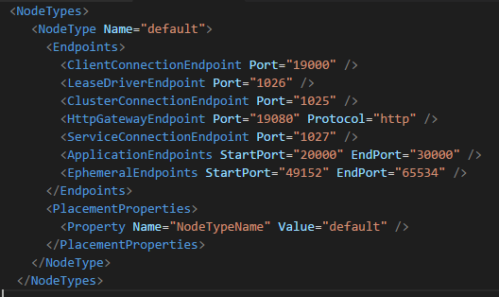
But what is a node?
A single server instance (physical or virtual)
Is a host for Service Fabric managed processes
Contains code and configuration
Associated with a Service Fabric “Node Type”
A “node type” is a group of nodes with similar properties.
Describes items such as the capacity and placement properties of each node.
Notes:
Lets pause for just a moment and look at what is a “node” in the cluster.
Simply put, a node is a single server/compute instance that acts as a host for service fabric managed application processes. The node contains the code, configuration, and sometimes data related to the services that are published to the cluster.
*click* (1) But most importantly, each node belongs to a defined “node type”.
*click* (2)
Node types are defined in the cluster’s manifest file. This definition includes items like the ports that the cluster should be aware of, placement properties (more on those in a bit), and optionally the capacity (memory, disk, etc…) of the nodes of this type. These values are used by the cluster help determine where to place the instances of the various services.

Slide 7
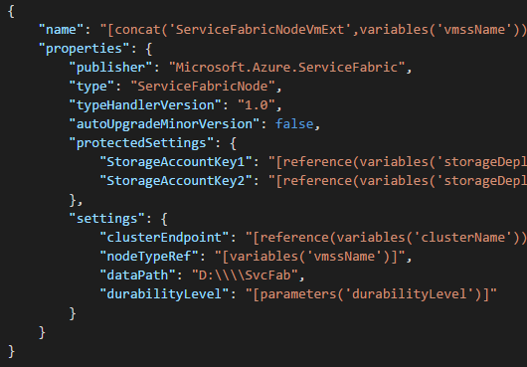
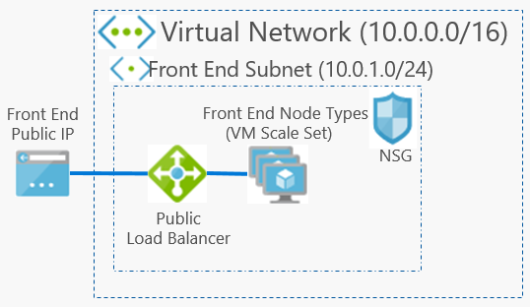
A simple cluster
1 VMSS = 1 Node Type
Placed in a vnet/subnet
Notes:
In Azure, we use VM Scale Sets. This specialized type of VM resource allows us to manage the group instead of the individuals. When using VMSS, there’s a one to one relationship between the VMSS and the Node Types. You can see this defined in the VMSS’s Service Fabric Extension configuration properties.
*click* (1) highlight node type
Now this node type needs to be a value that was delared as a node type in the cluster’s manifest. In example we saw on the previous slide, its here *click* (3)
But because the VMSS is just “managed VMs”, they still have to be placed inside of a network and subnet. So if we look at the earlier example, in Azure it could be represented like this.
*click* (2)
This is still a set of nodes, behind a load balancer, that is accessed from an external client. We’ll just use a VMSS so we’re not worried about individual nodes. We’ll use VM extensions to install the service fabric bits, and tie the nodes to the cluster via their defined “node types”.

Slide 8



Hidden Slide – for storing content only
Virtual Network (10.0.0.0/16)
Front End Subnet (10.0.1.0/24)
Front End
Public IP
Front End Node Types
(VM Scale Set)
NSG
Public
Load Balancer
Notes:
Only used to store the layout for the previous slide (which contains a resizable image of this)

Slide 9
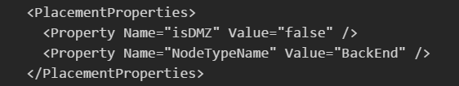
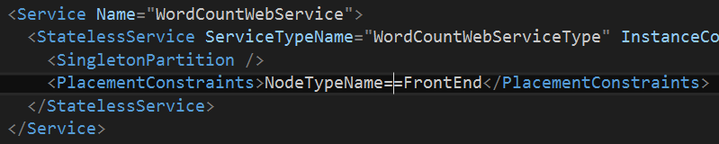
Placement Constraints
Put services where they are needed
Regulatory/security compliance
Hardware specialization
Placement Properties
Declared on the cluster nodes
Placement Constraints
Described by the service
Notes:
Node types may represent different network zones, but they can also mean different node properties such as “high memory” or “GPU enabled”…. Regardless of what they represent, you need to be able to tell service fabric how to use them determining where services should be placed. We do this by defining Placement Constraints in the service and/or application manifest.
We start on the left by defining the placement properties for a given node type. There’s one default property, “NodeTypeName” which corresponds, as you’d expect, with the name of the node type. But you can add any other key-value you pair you like.
Then, in the right we describe the placement constraints for the services. This example shows it being done in the application manifest. While you can define them in the service manifest, I prefer the application manifest as this allows us to leverage environment specific parameter settings so we can change the value at the time of deployment. Making it very useful when deploying to clusters with different node types and property settings. Say for example your local development environment and a production cluster.
More Info: https://brentdacodemonkey.wordpress.com/2016/09/11/placement-constraints-with-service-fabric/
There’s also one special node type, and there can be only one of these per cluster. And that’s the “primary” node type. This node type is where the Service Fabric specific services live.

Slide 10
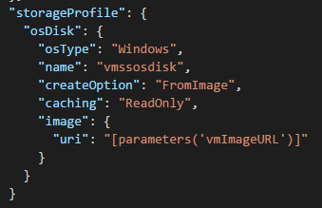
Bring Your Own OS
Simplifies startup of the VM
Pre-install necessary components/resources
Reduce complexity

Slide 11
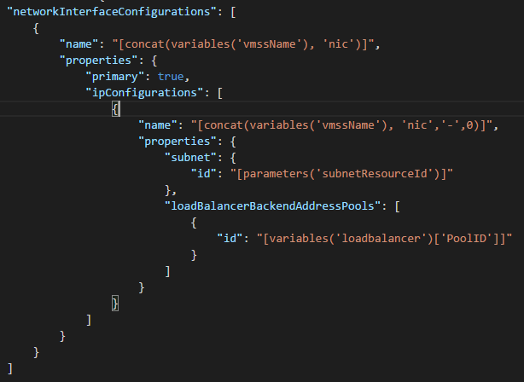
Bring your own VNET
If you have an existing infrastructure, don’t be afraid to use it
- a cluster can be placed in an existing vnet
A node is just a VM, configure it appropriately

Slide 12
Use your own vnet to…
Connect to on-prem via a VPN Gateway
- Access resources
Keep the cluster “private”
No external visibility
All access only done from within your network

Slide 13

A “DMZ” Cluster
Virtual Network (10.0.0.0/16)
Front End Subnet (10.0.1.0/24)
Back End Subnet (10.0.2.0/24)
Front End
Public IP
Front End Node Type
(VM Scale Set)
Private
Load Balancer
(10.0.2.4)
Three node types
Three Subnets
Public IP w/ Load Balancer
Private IP w/ Load balancer
NSG
NSG
Public
Load Balancer
Back End Node Type
(VM Scale Set)
Management Subnet (10.0.3.0/24)
Management Node Type
(VM Scale Set) primary=true
NSG
RDP Jump Box
Public
Load Balancer
Management Public IP
RDP Jump Box Public IP
Notes:
Now there will be situations where for various reasons, you’re going to need to create network isolation between services. This could be regulatory, it could be due to organization network requirements/standards. Whatever the reason, we can leverage the VM Scale Sets to help achieve this. We configure each VM Scale Set to be placed into a different subnet. Furthermore, we can then start leveraging a mix of public and private load balancers to help with directing traffic appropriately.
In this example, we’re also going to segregate the service fabric services from the other services. In the “management” subnet we’ll place our “primary” nodes. This technique is used in situations where you want to help restrict access (at a network level) and to help reduce the risk of service resource congestion.
Lastly, to ensure that the services deployed to the cluster land in the correct locations, we’ll leverage the node types, and specifically their placement properties.
Capacity: https://docs.microsoft.com/en-us/azure/service-fabric/service-fabric-cluster-capacity

Slide 14
Ports Required (by default)
Service Fabric Ports
Cluster Management: 19000, 19080
Reverse Proxy: 19008 (if enabled)
SMB: 445 (used by the application store)
“Fabric” services: 1025-1027
Service Fabric Ports
Ephemeral: 49152-65534
Application: 20000-30000
Notes:
When you start creating more complex clusters like this, you’ll also need to be aware of which ports are required between the nodes. Its important to note that most of these can be adjusted via the cluster manifest, so what we’re showing you here is the “default” ports.
Cluster Management is the “explorer” web portal and TCP management (used by things like powershell and cli).
*if* you’ve enabled the reverse proxy, you’ll need to allow 19008. But most of the time you’ll be accessing this via local host, so you can scope this based on your usage.
The SMB port of 445 is used by service fabric to move the application packages between nodes. So this needs to be open of publishing will fail.
The “fabric” services require ports 1025-1027 for connections between the clusters and their “fabric” system services. (cluster connection, service connection, lease driver).
The Ephemeral and Application ports are assigned for dynamic application ports and used for replication operations of stateful services.

Slide 15
Lets take a look…
Placement
Content © Microsoft
Notes:
Look over the solution in Visual Studio, highlight the placement constraints and parameter files. Show deployed the local “dev” cluster, and to a remote cluster. Explore the remote cluster with all its different properties.

Slide 16
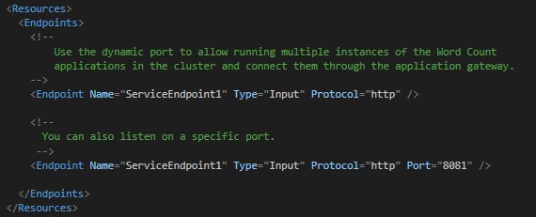
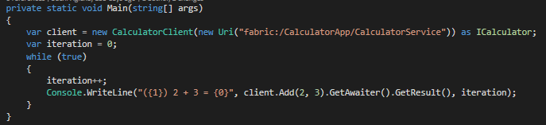
Service Port Assignment
Endpoint are declared in the service manifest
The “Port” is optional
Benefits of Fabric Assigned Port
Use cluster’s application range
Avoids port collisions
Resolve via the naming service
Notes:
Ok, hopefully the cluster seems a bit less magical now. So lets move on to the services in the cluster.
When you deploy a service to a cluster, if its going to be listening for inbound requests, you need to declare one or more endpoints. This declaration is typically done in the service manifest and used when the service is “registered” with the cluster’s application store. When declaring the endpoint, you have to give a protocol (http or tcp) and the type (input or output). Optionally, you can also specify a port that the service will be listening on.
Its this “optional” port I want to talk about for a moment. You certainly leverage this. In fact, if you’re accepting requests from outside of the cluster, you’re likely going to want to do this because you’re also probably using a load balancer of some time to direct external traffic to the cluster. And that port is something that load balancers usually need to know when directing traffic. So what happens if you don’t specify a port? Service Fabric will assign one to each instance of the service.
This usually leads to two questions… the fist is “what is the benefit” and the second is “how do I address the service”?
*click*
If you don’t specific a fixed port, service fabric will allocate a port from the “application port range” defined in its manifest. This allows service fabric to help avoid any port collisions. So two services, or even two instances of the same service, can both live on the same node within the cluster in (hopefully) perfect harmony. Something we couldn’t do if we used a fixed port of say ’80’. How many times have you tried to deploy something only to find there was already something running on your designated port? Well service fabric can help us avoid that altogether.
When the question comes about how to resolve an endpoint.
*click* This is the another feature of the naming service.
What you see here is a custom class that implements the ServicePartionClient and ClientFactoryBase classes. These classes interface with the naming service to resolve the endpoint of a service (in this case “fabric:/CalculatorApp/CalculatorService”), as well as handle common communication challenges like transient fault handling and retry. If you like, you can go even deeper, and not use these classes and instead get right to the heart of the naming service, but lets not get that deep into the weeds. At least for this session.
Useful links:
https://docs.microsoft.com/en-us/azure/service-fabric/service-fabric-connect-and-communicate-with-services#service-discovery-and-resolution
https://docs.microsoft.com/en-us/azure/service-fabric/service-fabric-service-manifest-resources
https://docs.microsoft.com/en-us/azure/service-fabric/service-fabric-reliable-services-communication#communicating-with-a-service
Sample:
https://github.com/Azure-Samples/service-fabric-dotnet-getting-started/tree/master/Services/WcfService/Calculator.Client

Slide 17
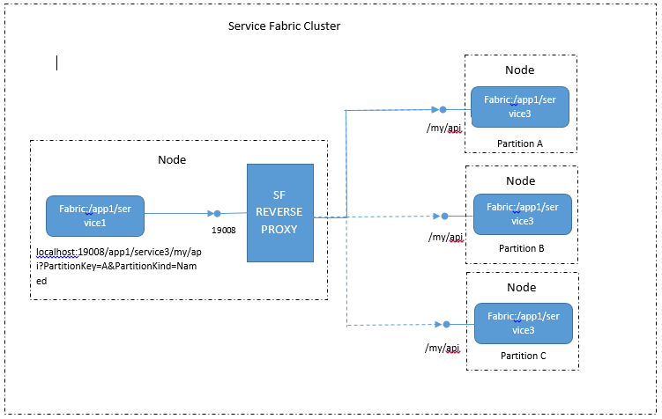
Reverse Proxy
localhost:19008/app1/service3/my/api
Things to Know:
Must be set up on the cluster in advance
Exposes ALL services on the cluster
Only does basic “round robin” routing
Does SSL termination (no HTTPs on the “back end” currently)
Notes:
If that isn’t enough, there’s another route to reaching services. Service Fabric includes a built in reverse proxy which you can choose to deploy if you so desire.
*click*
Addressing a service via the reverse proxy is as simply as directing traffic to localhost on the port you specified when the cluster was set up (19008 by default) with the application, service, and application. In this example we’re talking to *click* localhost:19008/app1/service3/my/api. “app1” is the application, “service3” is the service. “my/api” is the route for the endpoint.
Requests can be either tcp or http and are simply forwarded to an instance of the service as determined by the naming service.
Now there are a couple things you need to know about using the reverse proxy *click*
there’s no way to add the proxy to a cluster once its been set up. Adding the reverse proxy is a “setup” time decision
The proxy exposes all the services on the cluster via port 19008. And it provides zero access control. So I wouldn’t recommend putting it on the other end of a public load balancer.
Lastly, the reverse proxy, does not take into account the load on a given service instance. Its only going to due the most basic round robin routing. With most load balancers you can specify a probe that can be used to help a service tell the LB not to direct traffic when its under stress (by responding appropriately). The reverse proxy does not have this capability.
Lastly, when using SSL for a service, the reverse proxy does SSL termination. There’s no way to address “https” on the back end currently. Additionally, the proxy will use a single certificate.
Useful links:
https://docs.microsoft.com/en-us/azure/service-fabric/service-fabric-reverseproxy

Slide 18
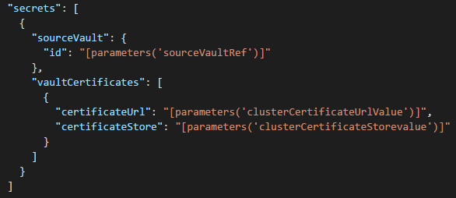
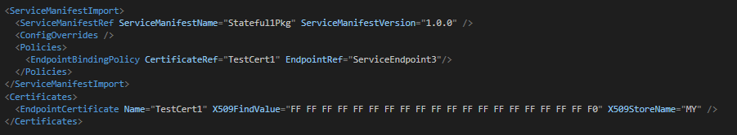
Application Certificates
The Cluster (VM Scale Set)
Add the certificate to Azure’s Key Vault
Declare to the VMSS (including where to put it)
For the service, its declared in the application
Certificate is declared with its thumbprint and the store name
Bind the endpoint to the certificate
Notes:
So… Speaking of certificates… how do we do application certificates? I’m going to discuss this in terms of an Azure managed cluster. In part because its slightly more complex, but also because if you can get it in Azure, doing it with a self-managed cluster should prove easy.
*click* Because the cluster is really just a collection of VM’s. We’ll start with getting the certificates into them. There’s a bit of detail here, and there’s a link to a detailed version of this in the presenter notes of this deck. So we’ll go over this quickly. We start by adding our certificates to an Azure Key Vault’s that has “azure deployment” enabled. This gives us a safe, online storage location for the certificates that can be referenced by Azure when we create/update our VMSS. *click* This is considered a secret for the VMSS.
What we have here is a snippet of an Azure Resource Manager (ARM) declaration for VMSS. It takes a reference to the Key Vault where the certificates are stored, and we then specify the individual certificates within that store we want, and where they should be placed on the VMSS instance. If you are doing this to a self-managed VM, you would simply install the certificate yourself using whatever approach you are most comfortable with. Be it an orchestrator like Chef or Pupper, remote powershell, or even manual setup by an operator. But because we’re dealing with Azure’s VMSS, we need to use this approach to ensure that any new VMs that are added, or ones that have to be “rebuilt” stick to our pre-defined configuration.
Azure Resource Manager and VMSS are again topics we could spend significant time on. So feel free to catch me afterwards to talk about this more. ☺
*click* Now for the application, we will start by declaring the service as having an ‘https’ endpoint. This is the same types of declarations we saw earlier when discussing ports. So I won’t show that again. But if we declared the endpoint as ‘https’, we’ll now want to leverage the application manifest to “bind” that endpoint to our certificate.
*click* we start by adding the certificate to the manifest. We’ll use the thumbprint for the certificate in question, and the store where its at.
*click* with that in place, we’ll then bind the certificate to the endpoint. The two “ref” properties here must match what we declared for the endpoint certificate, and the service endpoint.
Useful links:
https://docs.microsoft.com/en-us/azure/virtual-machine-scale-sets/virtual-machine-scale-sets-faq#certificates
https://docs.microsoft.com/en-us/azure/service-fabric/service-fabric-service-manifest-resources#example-specifying-an-https-endpoint-for-your-servicehttps://docs.microsoft.com/en-us/azure/service-fabric/service-fabric-cluster-security-update-certs-azure#adding-or-removing-client-certificates

Slide 19
Application and Service Upgrades
Upgrade Domains
In stages, one domain at a time
Code changes impact the application hosting process (impacting other services)
Breaking Changes
Health Checks
Specified in the optional “policies” section of the application manifest
Describes both “default” and service specific settings
Sets thresholds for maximum percentage of unhealthy: partitions, replicas, or services
To prevent a breaking change, services need to be compatible with +/- 1 version of their current.
Multiple Upgrade Types
Monitored: health of each upgrade domain checked before proceeding
Unmonitored Auto: on upgrade domain at a time, no health check
Unmonitored Manual: lets administrator upgrade one domain at a time
Notes:
If you watched various videos about service fabric, as some point you’ve likely see a demo of a “live upgrade” of an application. There’s nothing especially “magically” about this process. But I do want to spend a few moments to cover some of the basics.
*click* Upgrade Domains
When performing upgrades to service fabric applications/services/partitions, service fabric will leverage the defined upgrade domains. These were set at the time the cluster was created (in the cluster manifest). These are the same upgrade domains are also used when the cluster determines the placement of service partitions and replicas. However, we need to keep in mind that when we’re updating code, the host process is also impacted. And this in turn could impact other services within that same application. But service fabric knows this as well, and therefore takes this into account when placing all the services for a single application.
*click* Health Checks
When an the application service/partitions in an upgrade domain have been updated, an optional health check can be performed. Based on the policies defined in the application manifest, service fabric will make sure that the minimum percentage of the instances/partitions in that domain are “healthy” before it moves on to the next domain. These limits are defined in optional policy section of the application manifest as both defaults, and service specific values.
Its important to note that service fabric won’t really know what “healthy” means for your individual service. So its important that you instrument your services with custom health events.
*click* Multiple Upgrade Types
When doing an upgrade, you have three different types to choose from.
Monitored (the default and recommended approach), will do one upgrade domain at a time, and verify the health checks pass before proceeding on.
Unmonitored “Auto” does them an upgrade domain at a time, but doesn’t bother with waiting for the health checks.
Unmonitored “Manual” is administrator controlled, allowing for an operator to determine when to do each upgrade domain.
There’s technical a fourth option of “upgrade everything right now”. But that’s not something we would ever recommend for a production service. ☺
Now admittedly, you could easily do an hour long presentation on just what’s discussed in this one slide. But we don’t have time for that, so I would encourage you to explore this topic at your leisure using the links that are included in this slide’s presenter’s notes. But there’s one last item I want to touch on here….
*click* Breaking Changes
For any of this to work with zero downtime, we need to be sensitive to breaking changes. At any point during an upgrade, a remote client could be connecting to either the new version of the service or an older one. You could make the argument that it’s the client that needs to be compatible, but right now we’re talking about upgrading our service. And as such, I want to call out that if its your service, its also your responsibility not to break clients that depend on you. Be they internal or external.
Useful links:
https://docs.microsoft.com/en-us/azure/service-fabric/service-fabric-application-upgrade
https://docs.microsoft.com/en-us/azure/service-fabric/service-fabric-application-upgrade-tutorial
https://docs.microsoft.com/en-us/azure/service-fabric/service-fabric-application-upgrade-parameters
https://docs.microsoft.com/en-us/azure/service-fabric/service-fabric-health-introduction
https://docs.microsoft.com/en-us/azure/service-fabric/service-fabric-diagnostics-how-to-report-and-check-service-health

Slide 20
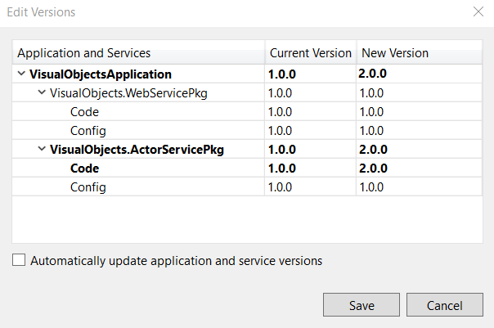
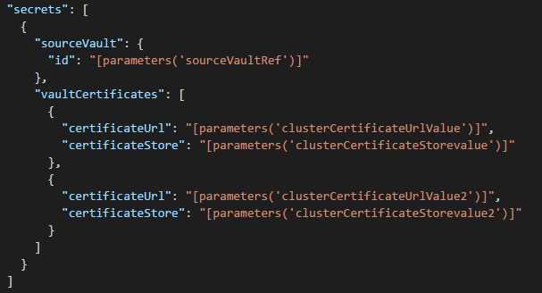
Certificate Rotation
Add a new certificate to the nodes
Add it to the key vault
Update the VMSS to reference the new certificate
Update the service
Update Application Manifest
Increment the version
Publish and deploy the upgrade
Notes:
Ok, we’ve covered certificates, as well as application upgrades. So lets combine those two topics to update a certificate.
*click* we start by adding the certificate to our nodes.
Just like we did before, we start by adding the certificate to the Azure Key Vault. With the certificate in place, we then update the VMSS configuration to add the new certificate. *click*
If you’ve done any java coding, you’ll notice that in ARM we use JSON notation to describe the resources we’re creating. In this case “valutCertificates” is an array. And all we’ve done is add a second object to that array that describes the new certificate. We add a second certificate because this update will be completed before we update the application’s bindings. So its important that the we don’t remove the old certificate until we know its not in use any longer.
*click* with the new certificate now in place, we’ll update the service.
We update the application manifest, changing the thumbprint that’s associated with our binding to the new value and optionally the new certificate store. *click* Next, we increment the version of the application and/or service. With these changes complete, we then publish the updated application and deploy it to the cluster much like we did before.
Useful links:
https://docs.microsoft.com/en-us/azure/service-fabric/service-fabric-cluster-security-update-certs-azure
Image from: https://docs.microsoft.com/en-us/azure/service-fabric/service-fabric-application-upgrade-tutorial

Slide 21
Lets take a look…
Zero Downtime Upgrade
Content © Microsoft
Notes:
Do certificate rotation for an application certificate on the cluster. Show running upgrade.

Slide 22
Review
Leveraging Node Types
What is a cluster
Leveraging Node types
Custom OS and Network options
Addressability, Upgrades, and Security
Endpoint Resolution
Rolling Upgrades
Certificate Management

Slide 23

Thank you!
https://aka.ms/brent-servicefabric-bhworkshop
Brent Stineman
DX/TED, Azure Specialist, Cloud Evangelist
Email: brestin@microsoft.com
Twitter: @brentcodemonkey
Web: http://brentdacodemonkey.wordpress.com
→
Creating quality bugs since 1992!
Notes:
Image Courtesy of Brent.
Purple dye all over his face is courtesy of his daughter

